Slide 1
Customer Retention Analysis
Meera Radhish

Slide 2
Overview
What is Retention Analysis
Customer Retention Analysis
Data preparation and cleaning
Data Analysis and Insights
Summary

Slide 3
What is retention Analysis
Retention analysis (or survival analysis) is the process of analyzing user metrics to understand how and why customers churn. Retention analysis is key to gaining insights on how to maintain a profitable customer base by improving retention and new user acquisition rates.

Slide 4
Customer Retention Analysis
Customer Retention Analysis is the second task given by PwC Switzerland as part of virtual Internship program in the field of Data Analytics. The task is to analyse the customer retention data to help the Retention Manager with following requirements
Define proper KPIs
Create a dashboard for the retention manager reflecting the KPIs
Write a short email to him (the engagement partner) explaining your findings, and include suggestions as to what needs to be changed

Slide 5
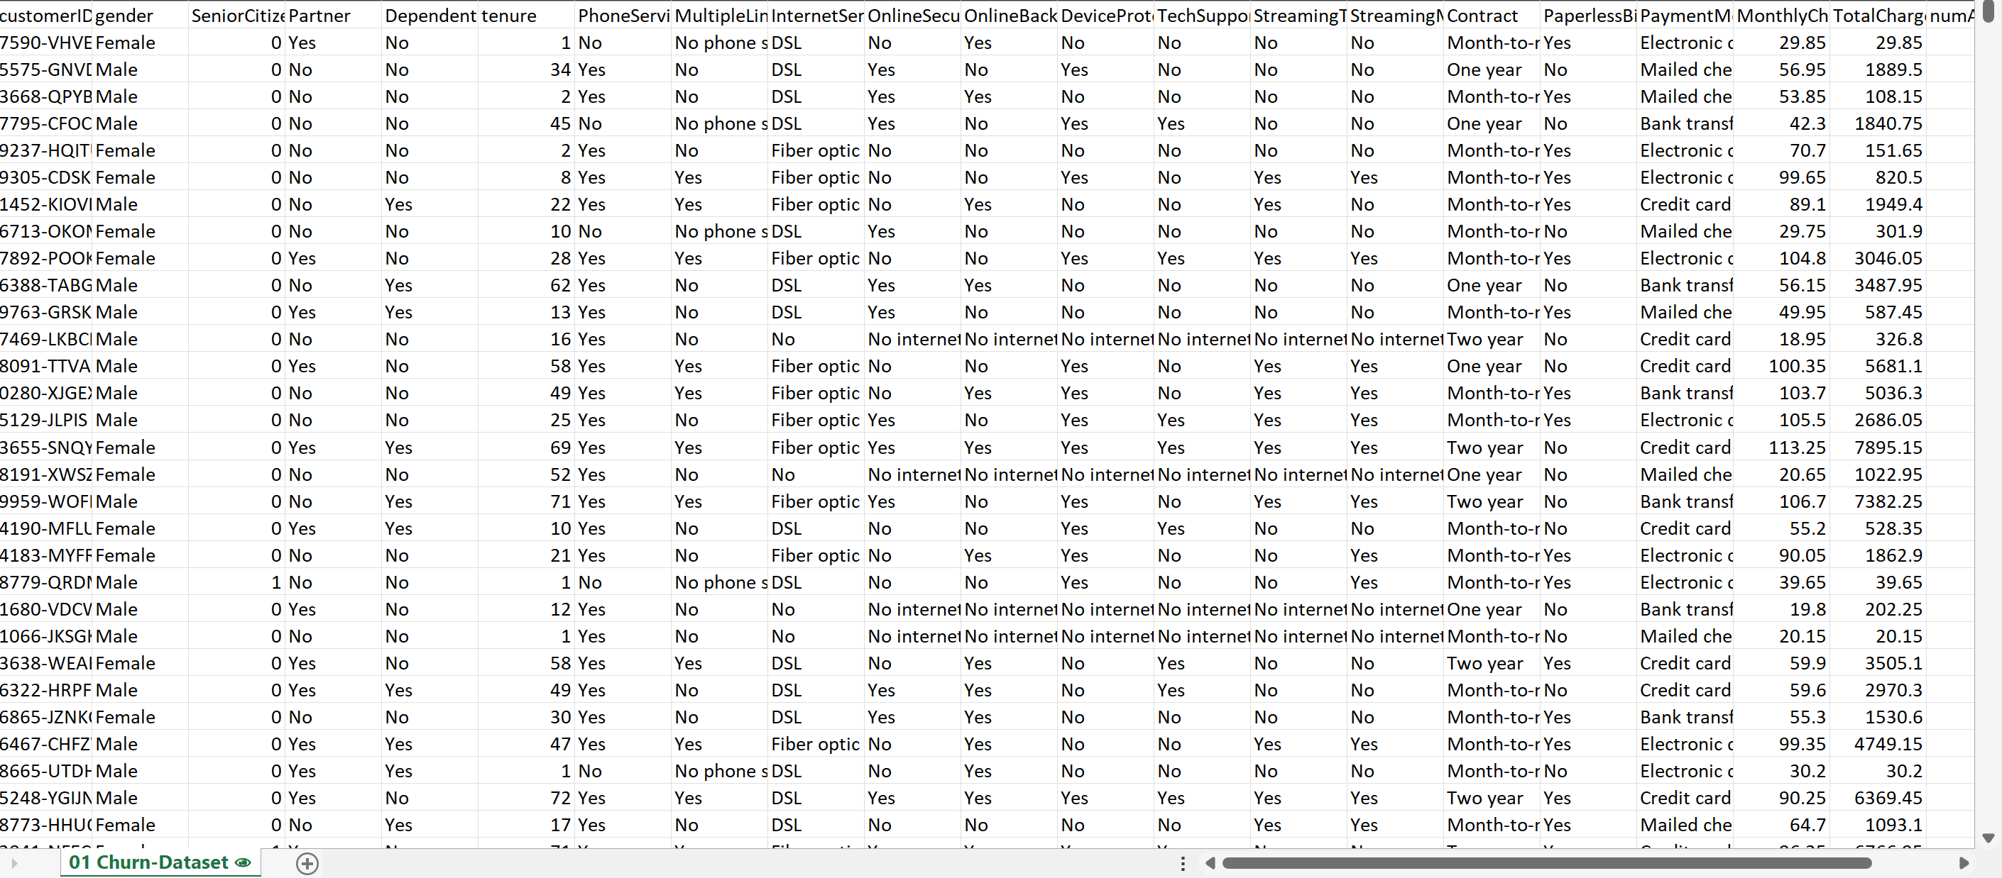
Information about Data
The data set (was provided by PwC in an Excel file) consist of 23 columns and 7044 rows including customer ID,gender, senior citizen, tenure, payment method,internetservice and manymore.

Slide 6
Data Cleaning
The data ain‘t always clean so it has to be cleaned for easing the analysis process.
From the table , it‘s found that some of the columns have values 0 s and 1s representing No and Yes . Inorder to have an accurate data set those coloumns have to be cleaned by using Find and Replace function.
Data types also changed accordingly
Also some coloumn contains null values . Those are also replaced with 0
Replaced the headers with approproiate name using Coloumn Rename.
The values are rounded into two decimal places using Round function.

Slide 7
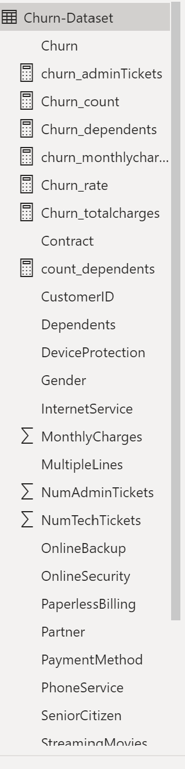
After the basic cleaning, the file then moved into Microsoft Power BI and some measures were created to calculate some metrics for the Dashboard.

Slide 8
Analysis and Insights

Slide 9
After getting the data cleaned and moved into Power BI Proper, it‘s time for analysis to be done for answering the questions. Some DAX measures were created to calculate Churn rate . One more coloumn is added to get the Tenure range.

Slide 10
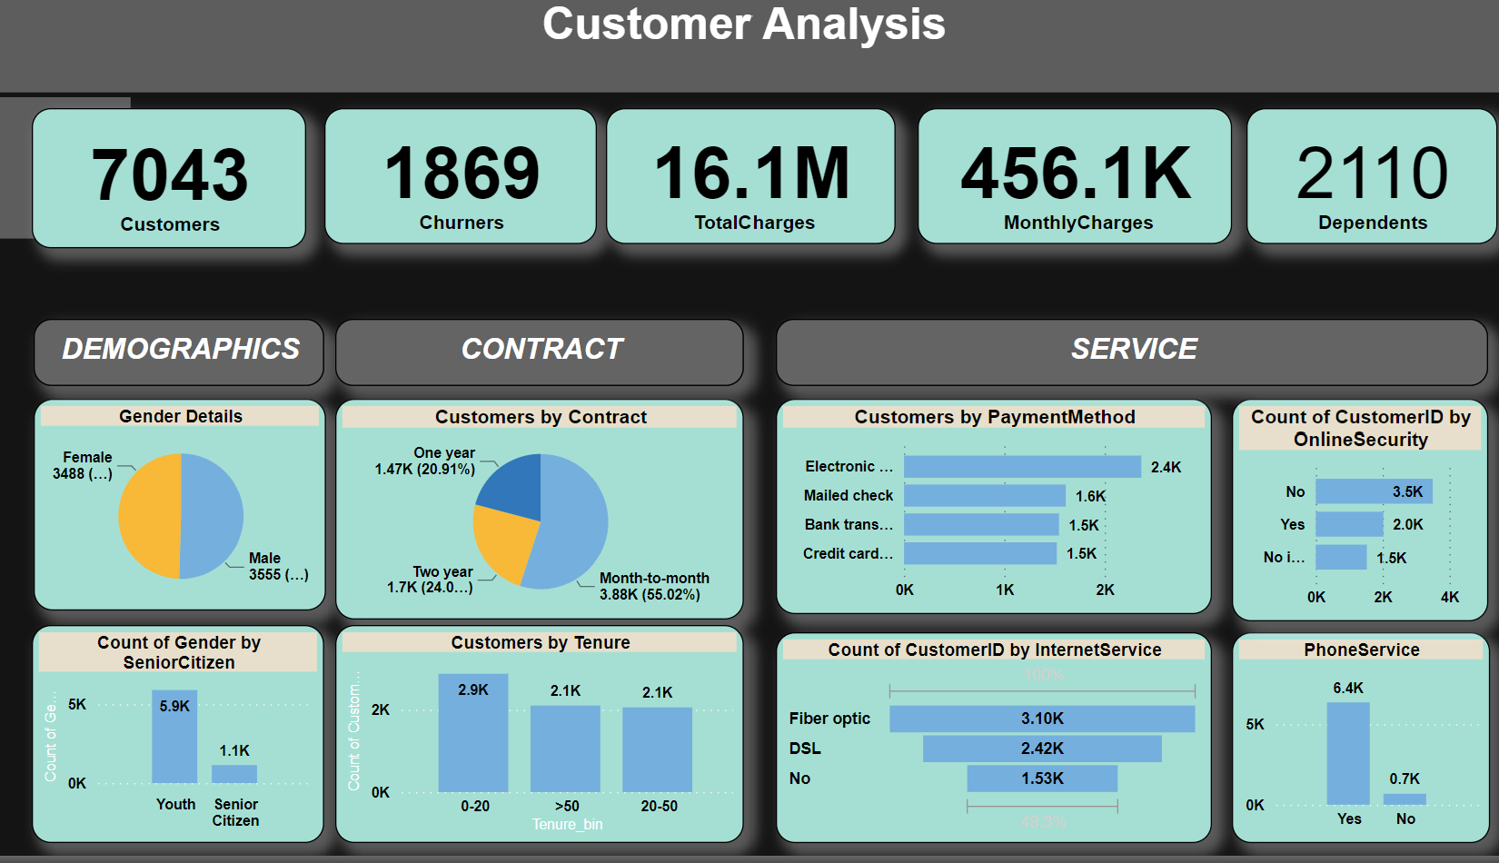
Customer Dashboard

Slide 11
Insights
Insights getting from dashboard are:
KPI s for the Customers
Demographic Info about Customers- Gender, category, dependents
Contract type and Services , the customer signed up for.

Slide 12
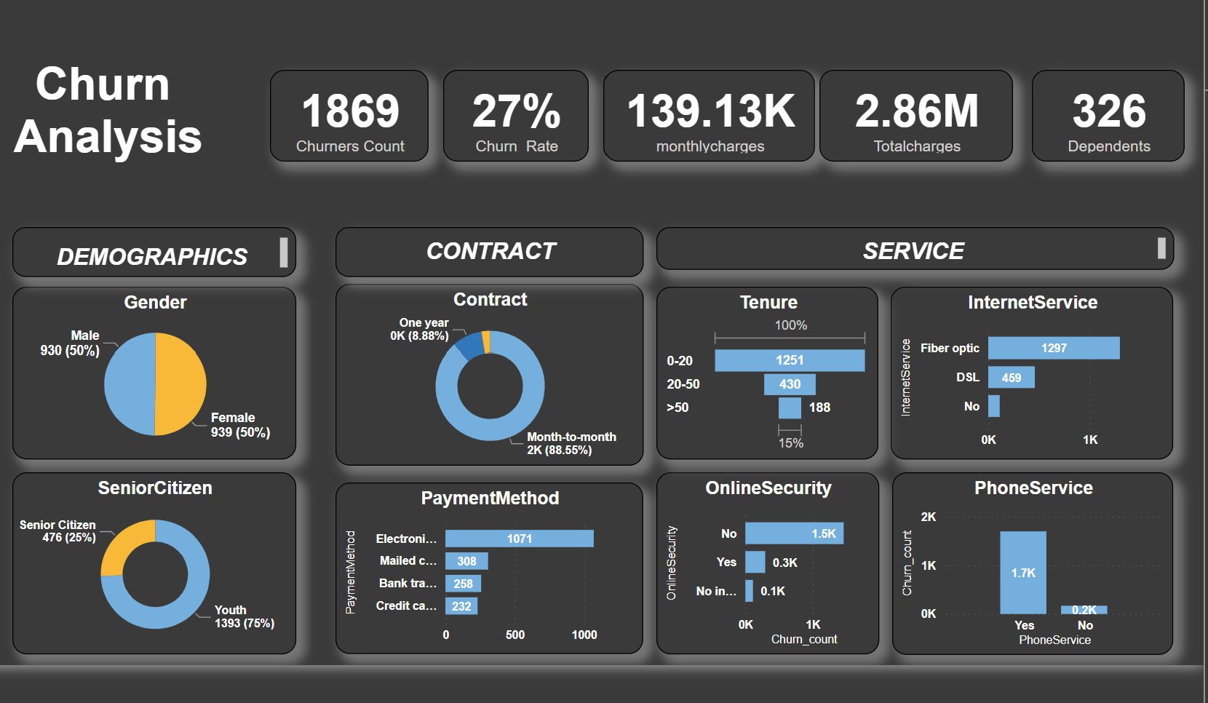
Churner DAshboard

Slide 13
Insights from Churner Analysis
From KPI‘s it‘s clear that there are altogether 1869 churn customers with 326 dependents.
The female to male ratio is 50%
25% of churn customers are Senior Citizens
Churn customers prefer Month to Month contract(88%) and preffers to pay using Electronic payment method.
Majority of churn customers uses Phone service and Internet Service
Also Majority custmers comes under 0-20 Tenure and doesn‘t use Online security.

Slide 14
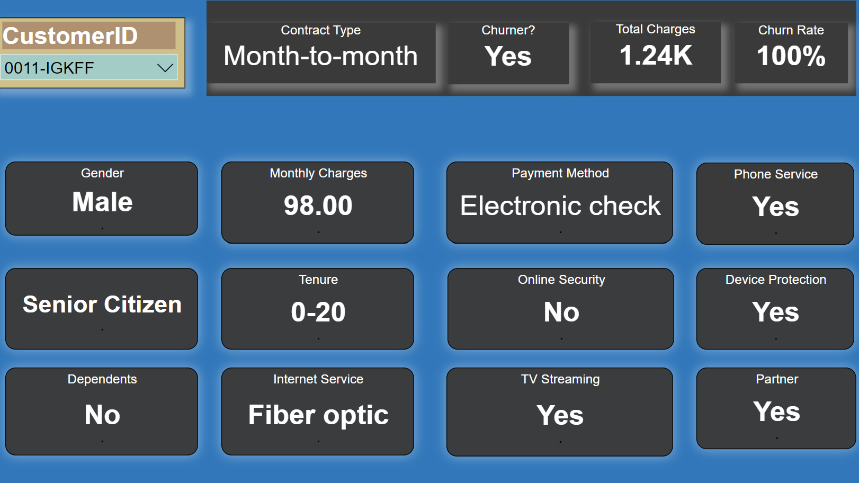
Customer Dashboard

Slide 15
From the customer dashboard we will get all the account information related to individual customer.
Thus from all these three dashboards Retention manager will be able to get the overview of customers as well as churners and also individual customer details and thus by he can identify individual customer for implimenting further retention plan.

Slide 16
Thank you

